Slide 1
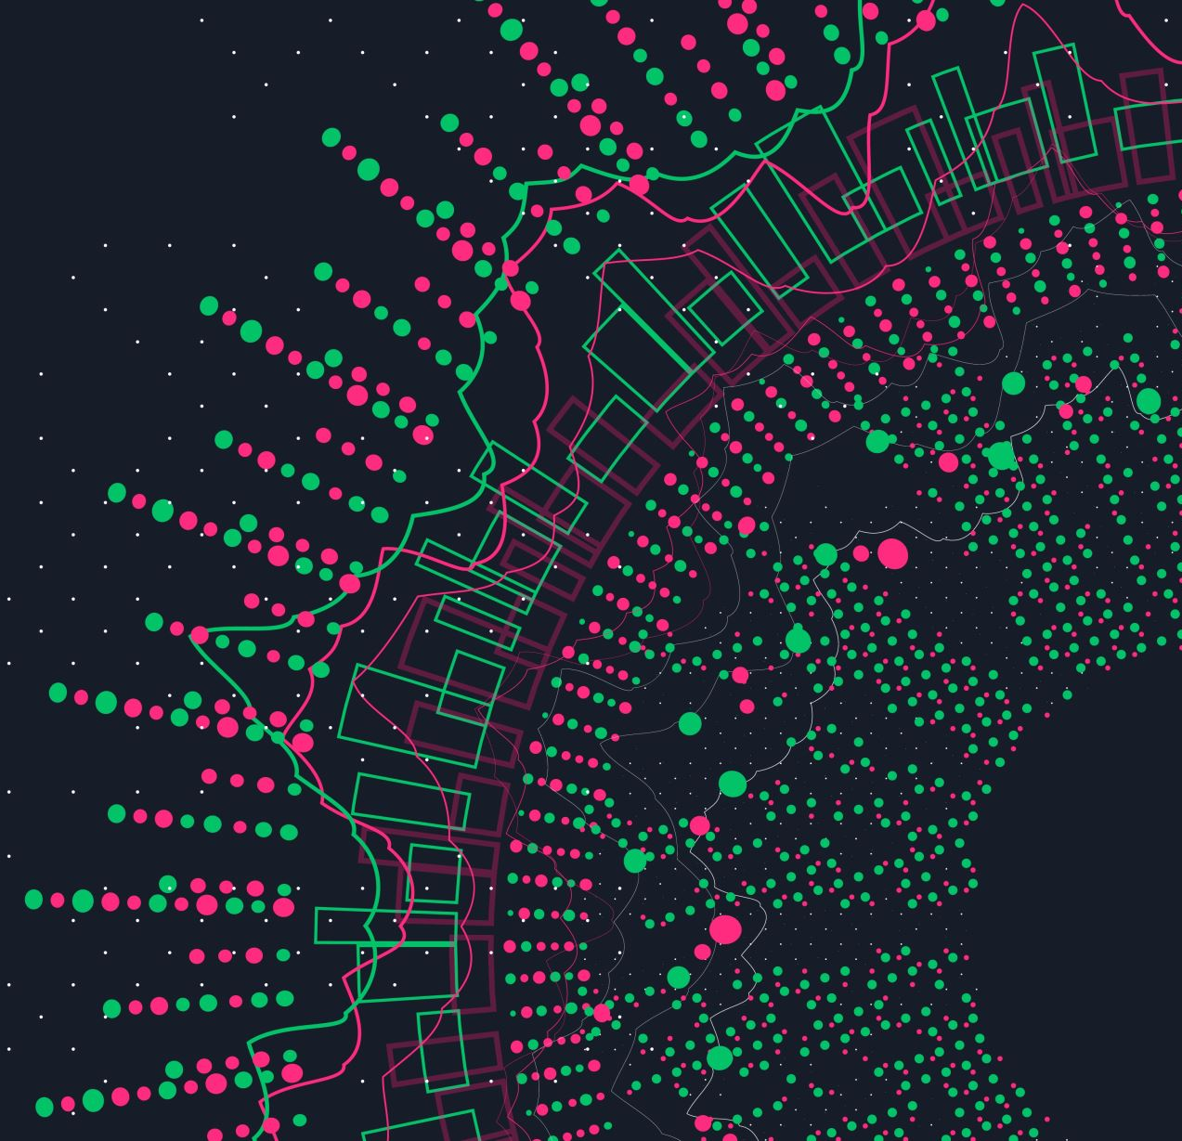
SyriaTel Customer Chrun Prediction and Reduction
William Itotia

Slide 2

Overview
SyriaTel, a telecommunications company, is facing customer churn issues. Customer churn, the act of customers discontinuing services, is a critical problem impacting revenue. The Chief Marketing Officer aims to gain insight from us to predict and reduce churn rates to enhance customer loyalty and revenue growth.

Slide 3

Business and Data Understanding
The primary stakeholder for this project is the Chief Marketing Officer (CMO) of SyriaTel. The CMO is responsible for overseeing the company's marketing strategies and customer retention efforts. By identifying patterns of customer churn, the CMO can implement targeted marketing campaigns and retention strategies to minimize churn rates and enhance customer loyalty.
Our objectives are to:
1. Identify causes of customer churn.
2. Predict customer churn rates.
3. Reduce customer churn rates.
The project utilizes the SyriaTel Customer Churn dataset, containing information on customer attributes and churn status.

Slide 4
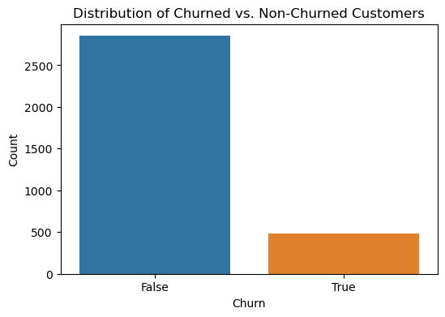
Visualizations
We have a higher number of customers that do not churn compared to customers that do churn which is a good sign.

Slide 5
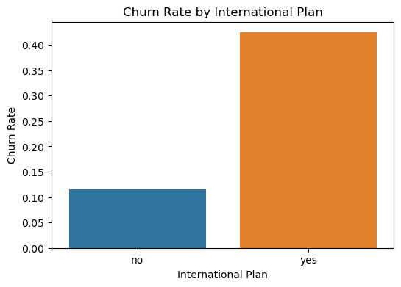
Visualizations
International Plans seem to have a higher churn rate than the national one. Which seems to be very high having a churn rate of 0.04.

Slide 6
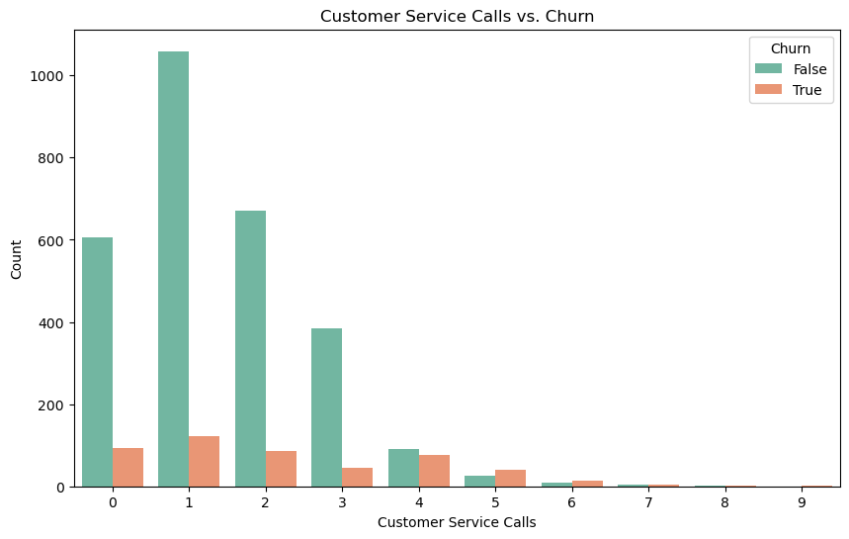
Visualizations
The higher the number of customer service calls the less likely a customer is to churn

Slide 7
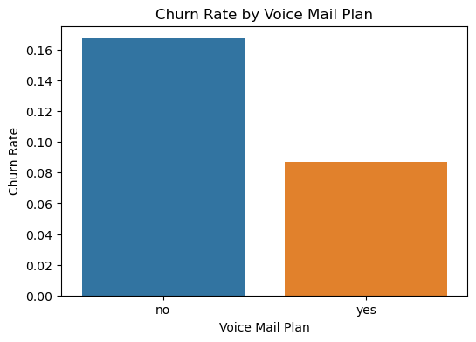
Visualizations
Customers with a voice plan have a low rate of churn seen at only 0.09 as compared to the ones without a voice mail plan.

Slide 8

Modelling
We chose to use XGBoost for our modeling because it's good at predicting whether customers will churn or not. During our testing, we found that it's accurate about 97% of the time, which means it's usually right when it makes a prediction. It's especially good at finding customers who are likely to churn, catching about 96% of them. Even when we tested it with new data, it stayed accurate around 96% of the time, which shows that it's dependable in real-world situations. From the model we saw that the most influential features that affect customer churn are international plan, number vmail messages, some States, customer service calls and total day minutes.

Slide 9

Evaluation
Explaining Causes of Customer Churn:
International Plan: Customers with an international plan are more likely to churn. This could be due to high costs or dissatisfaction with the plan.
Total Day Minutes: Higher usage during the day might correlate with churn, possibly indicating that high-usage customers are more sensitive to service quality or pricing.
Voice Mail Plan: Customers without a voice mail plan are less likely to churn, suggesting that the voice mail plan might not be meeting customer needs.
Customer Service Calls: Customers that receive frequent customer service calls(above 5) are less likely to churn, suggesting that Syriel should increase the number of customer service calls that they make.

Slide 10

Recommendations/ Next Steps
Predicting Churn:
The xgboost model that we are using achieves an accuracy of 96% and a ROC AUC score of 92%, indicating strong predictive power and the model's ability to discriminate between classes eliminating bias
Reducing Churn:
Syria Tel’s next steps should be to reduce churn by doing the following:
Focus retention efforts on customers with high predicted churn probabilities, offering tailored incentives and improving service quality in identified areas.
Which can be done by offering a more incentivized international plan package e.g with better rates.
Ensure high quality services to customers that use the product the most as they bring in the most money and losing them would cost the company a lot.
Offer a voice mail plan to more customers as it is seen that they are less likely to churn. Finally, communicate with the customers through customer service calls as you can be able to gain their feedback and implement what they are suggesting. As it is seen that churn rate reduces as customer service calls increase.

Slide 11

Thank You
William Itotia - Data Science

